Slide 1
A340 Lecture 8
JavaScript

Slide 2
General info about JavaScripts
Must be identified as a JavaScript
Requires JavaScript support in browser
Unrelated to the Java language
Functions are usually declared in page header
Can be inline or in a different file
Functions can be invoked by an event
Limited scope and language
Arrays, Boolean, Number and Date Objects
Time and date
Math
String and regular expressions

Slide 3
JavaScript Removing framesets
<head> <script language="JavaScript" type="text/javascript"> <!- -
function removeFrames() {
if (top.location != location) { top.location.href = document.location.href ; }
} --> </script>
</head>

Slide 4
A simple version
<SCRIPT language=JavaScript>
<!- -
if (top.location != location) { top.location.href =
document.location.href ; }
-- >
</SCRIPT>

Slide 5
Loading in JavaScript Files
<head>
<script type="text/javascript" src="Script1.js"></script>
<script type="text/javascript" src="Script2.js"></script>
</head>

Slide 6
JavaScript Mouse Events
onmousedown A mouse button is pressed
onmousemove The mouse is moved
onmouseout The mouse is moved off an element
onmouseover The mouse is moved over an element
onmouseup A mouse button is released
onclick Mouse clicks an object
ondblclick Mouse double-clicks an object
onreset The reset button is clicked
onresize A window or frame is resized
onselect Text is selected
onsubmit The submit button is clicked

Slide 7
JavaScript Events
onabort Loading of an image is interrupted
onload A page or an image is finished loading
onunload The user exits the page
onblur An element loses focus
onfocus An element gets focus
onkeydown A keyboard key is pressed
onkeypress A keyboard key is pressed or held down
onkeyup A keyboard key is released
onchange The user changes the content of a field
onerror An error occurs when loading a document or an image

Slide 8
Client Side Preprocessing with validate.js
Available from Apple:
Source: http://developer.apple.com/internet/webcontent/examples/validate_source.html
Documentation: http://developer.apple.com/internet/webcontent/examples/validate_source.html
Advantages:
Preprocesses the contents of a form
Highlights the errors as they happen
Imposes little server side overhead
Object-oriented access to the fields and values

Slide 9
Using validate.js
Master function
function checkWholeForm(theForm) {var why = "";
why += checkEmail(theForm.email.value);
why += checkPhone(theForm.phone.value);
why += checkPassword(theForm.password.value);
why += checkUsername(theForm.username.value);
why += isEmpty(theForm.notempty.value);
why += isDifferent(theForm.different.value);
for (i=0, n=theForm.radios.length; i<n; i++) {
if (theForm.radios[i].checked) {
var checkvalue = theForm.radios[i].value;
break;
}
}
why += checkRadio(checkvalue);
why += checkDropdown(theForm.choose.selectedIndex);
if (why != "") { alert(why); return false; }
return true;
}

Slide 10
Check functions
Name:
function checkUsername (strng) {
var error = "";
if (strng == "") { error += "You didn't enter a username.\n"; }
elsif ((strng.length < 4) || (strng.length > 10)) {
error = "The username is the wrong length.\n”; }
else { var illegalChars = /\W/;
// allow only letters, numbers, and underscores
if (illegalChars.test(strng)) {
error = "The username contains illegal characters.\n";
}
}
return (error)
}

Slide 11
Linking it into the form
Use events:
Field by field: onBlur()
<script type="text/javascript" src="/path/validate.js"></script>
<form method="post" onsubmit="return autocheck(this)">
...
<input type="text" name="sent" onblur="fixRecentDate(this,2000)"/>
<input type="text" name="when" onblur="fixTime(this)"/>
<input type="text" name="phone" onblur="requireValue(this)*fixPhone(this,'509')"/>
<input type="text" name="money" onblur="fixMoney(this)"/>
...
</form>
An example: http://webcoder.info/downloads/validate.html
Overall form: onSubmit()
<form method="post" onsubmit="return autocheck(this)" action="...">

Slide 12
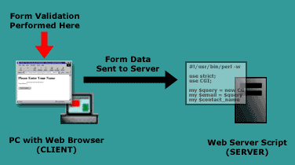
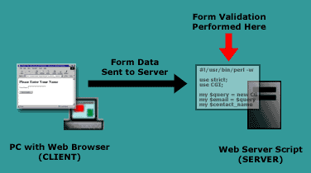
Data validation
Client Side
Server Side

Slide 13
WARNING!!!
Client submissions can easily be spoofed.
Even if you validate on the client side you must validate on the server side too!

